Slide 1


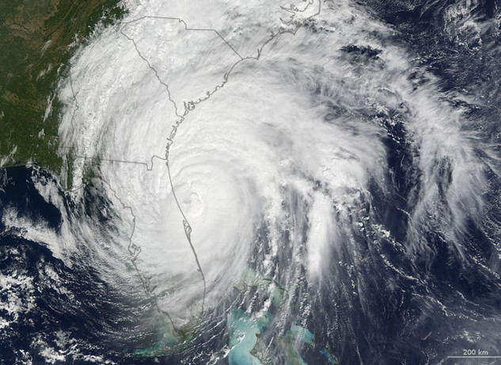
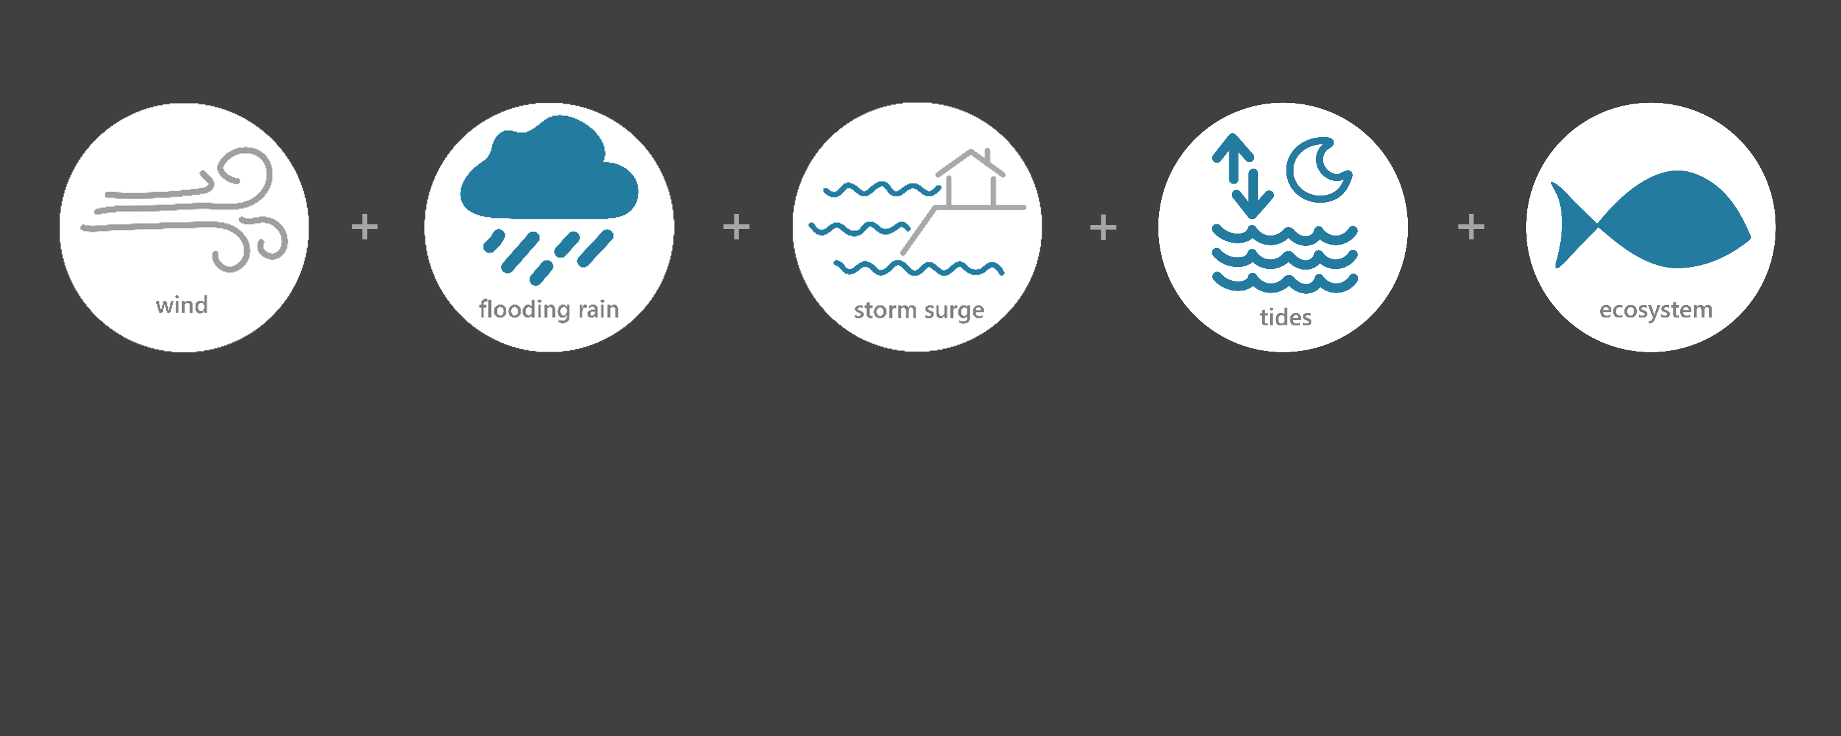

[ OCT 5 – OCT 10, 2016 ]
HURRICANE MATTHEW
2
Category
(extremely dangerous)
11.4
Inches of Rain
41
Miles per hour
of Max Wind Gusts
3-5
Feet of Inundation
(max)*
Monitoring the Impact of Hurricane Matthew at “Ace Basin NERR”
On October 8th, Matthew traveled northward about 50 n mi offshore of the Georgia coast as a category 2 hurricane. Matthew’s track was headed directly towards the islands near Beaufort, South Carolina, but prior to reaching land made a sharp turn toward the northeast and weakened in intensity. Matthew moved parallel to the South Carolina coast as a category 1 hurricane bringing hurricane-force wind gusts and heavy rains to coastal regions of the Carolinas. The effects of Matthew were observed at the ACE Basin Research Reserve through the System-Wide Monitoring Program (SWMP), which tracks short-term variability and long-term change in weather and water quality in the areas surrounding Beaufort, South Carolina.
Data shown are based on the ACE weather monitoring site
*NHC Report AL142016
Created on May 27, 2022

Slide 2

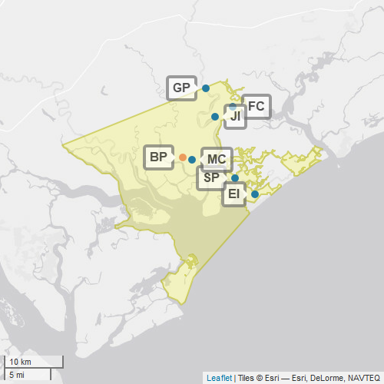
ACE
ACE Basin (Ashepoo-Combahee-Edisto) is one of 30 sites in the National Estuarine Research Reserve Systems (NERRS). Each site is a state-federal partnership that combines research, monitoring, and education to advance the understanding and management of estuarine environments.
ACE
NERRS
Centralized Data
Management Office
ACE Basin Storm Monitoring
ACE Basin operates a weather station located at Bennett's Point (BP) and maintains six continuous, long-term water quality stations at Fishing Creek (FC), Mosquito Creek (MC) St. Pierre (SP), Grove Plantation (GP), JehosseeIsland (JI), and Edisto Island (EI) locations. ACE Basin is part of the SWMP. As Hurricane Matthew approached South Carolina, ACE Basin monitored the weather and water quality, collecting data every 15 minutes for the following parameters: air temperature, relative humidity, atmospheric pressure, rainfall, wind speed and direction, water temperature, depth, salinity, dissolved oxygen, turbidity, and pH.
Weather Station
Water Quality Sample Location

Slide 3
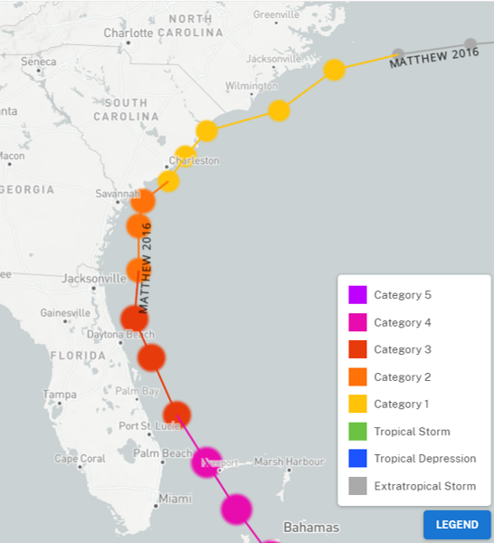
Matthew traveled along the Florida coast as a category 3 hurricane. Matthew weakened to a category 2 near the Georgia coast before transitioning to a category 1 near South Carolina. Matthew made landfall just south of McClellanville, South Carolina on October 8th.
More than 800,000 homes and businesses lost power across South Carolina.
In Beaufort County, trees were knocked down and fell into several homes.
The northbound lane of the Harbor Island Bridge was washed out. Many boats, marinas, and roofs of homes were damaged.
Source: https://oceanservice.noaa.gov/news/historical-hurricanes/
Matthew was a category 2 hurricane as it approached the ACE Basin NERR. A subtropical ridge caused Matthew to make a sharp turn to the northeast and weaken further. Matthew made landfall near McClellanville, SC after passing ACE.
ACE
NOAA NCEI estimates that wind and water damage totaled approximately $10 billion, making Matthew the 10th most destructive hurricane to affect the United States.
Aquatic life, like oysters, crabs, shrimp, fish, phytoplankton, etc. rely on specific levels of salinity and dissolved oxygen to thrive and survive. The weather impacts from Matthew caused significant drops in the levels of salinity and notable changes to the regular diurnal cycle of dissolved oxygen, potentially stressing organisms.
Station | Date | Rainfall Total (in) | Rainfall Average Intensity (in/hr) | Wind Speed Max (mph) | Wind Speed Average (mph)
Bennett's Point | 10/7/2016 | 2.44 | 0.102 | 30.0 | 14.0
Bennett's Point | 10/8/2016 | 8.95 | 0.373 | 41.2 | 27.7
Bennett's Point | 10/9/2016 | 0.00 | 0.000 | 19.0 | 10.8
Bennett's Point | 10/10/2016 | 0.00 | 0.000 | 18.3 | 8.0
Bennett's Point | 10/11/2016 | 0.00 | 0.000 | 2.2 | 0.9
Peak wind measurements were recorded when Matthew traveled along along the South Carolina coast on Oct. 8. Heavy rainfall occurred on both Oct. 7 and Oct. 8.
Data reporting time periods for Hurricane Matthew: 10/7/2016 - 10/11/2016

Slide 4
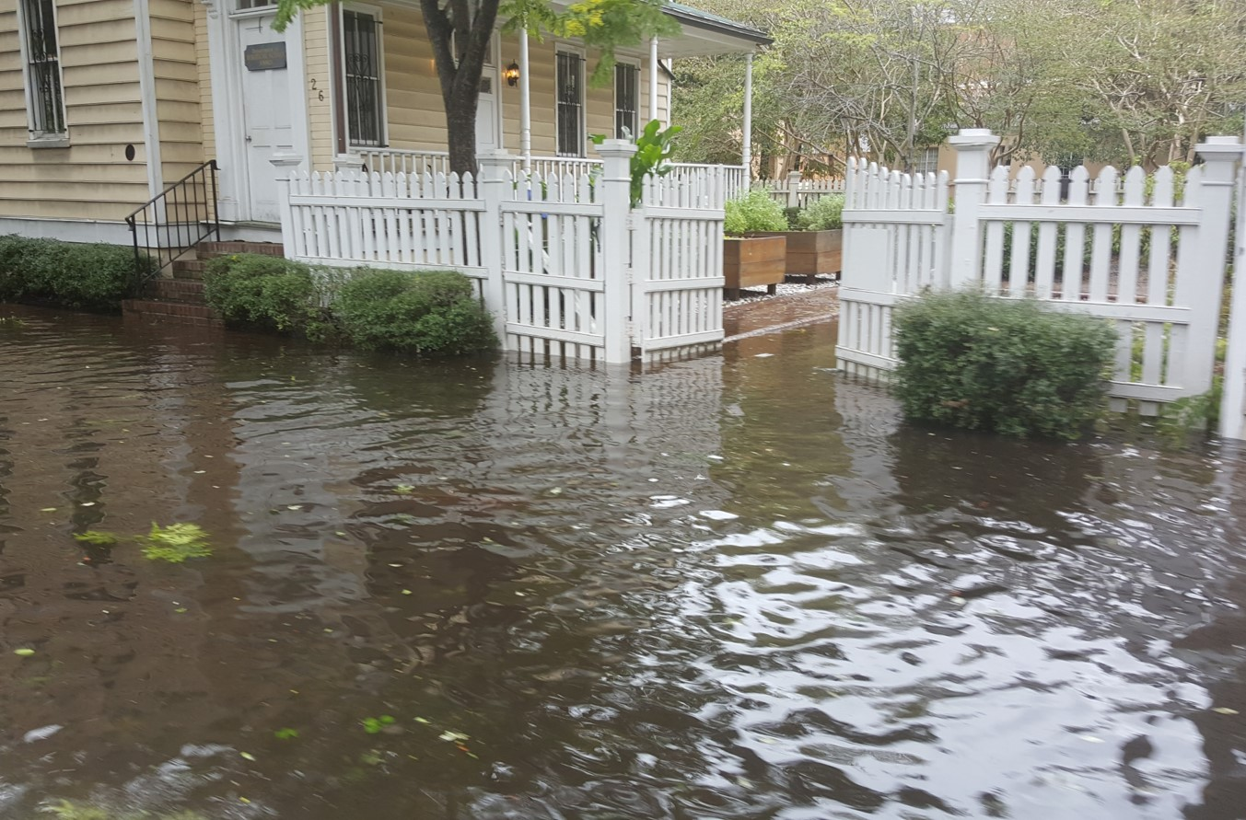
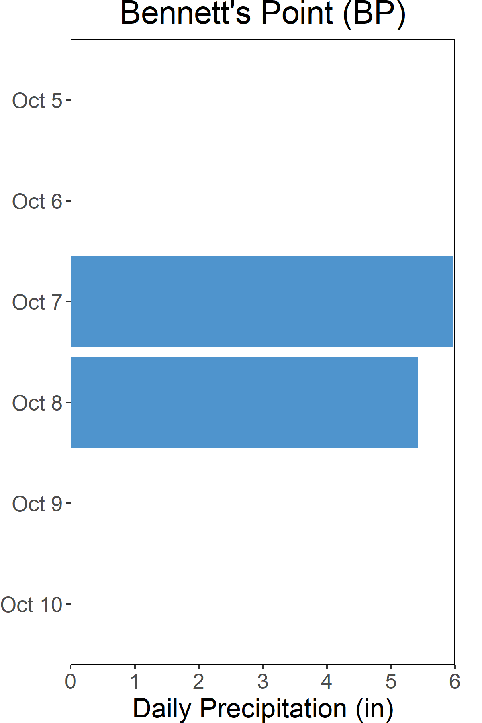


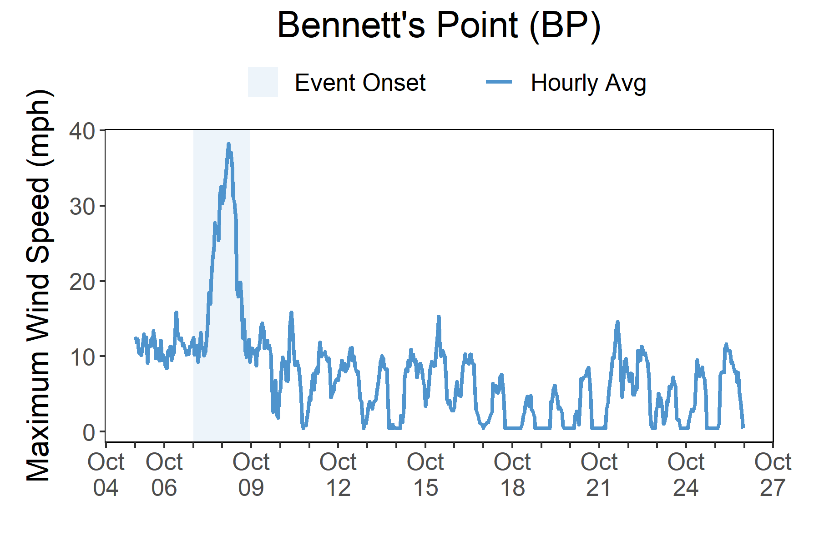

Rainfall
Matthew brought heavy rains, high winds, storm surge, and flooding to South Carolina.
A total of 11.4 inches of rainfall fell in the reserve area over the course of two days.
Torrential rains fell over the South Carolina coast with 11.4 total inches of rainfall recorded at the Bennett’s Point weather station. The effects of storm surge produced maximum inundation levels of 3-5 ft above ground level in South Carolina. In Beaufort County, inundation occurred at several locations along highway US21 as a result of storm surge.
The combination of storm surge and inland freshwater flooding caused by excessive rainfall resulted in damage to more than one million structures, forcing businesses from Florida to North Carolina to temporarily close. The max wind speed recorded at Bennett’s Point was 41 mph. Matthew’s wind field caused structural damage to homes and businesses. Downed trees and utility lines caused massive power outages.
Across South Carolina, Matthew caused over a billion dollars in damage, left 800,000 people without electrical power, and caused environmental problems.
Daily Rainfall measurements at the weather station from Oct. 5 through Oct. 10.
Wind Speed
Max wind speed recorded at the reserve was 41 mph on Oct. 8
Maximum Wind Speed readings at the weather station from Oct. 5 through Oct. 26.

Slide 5
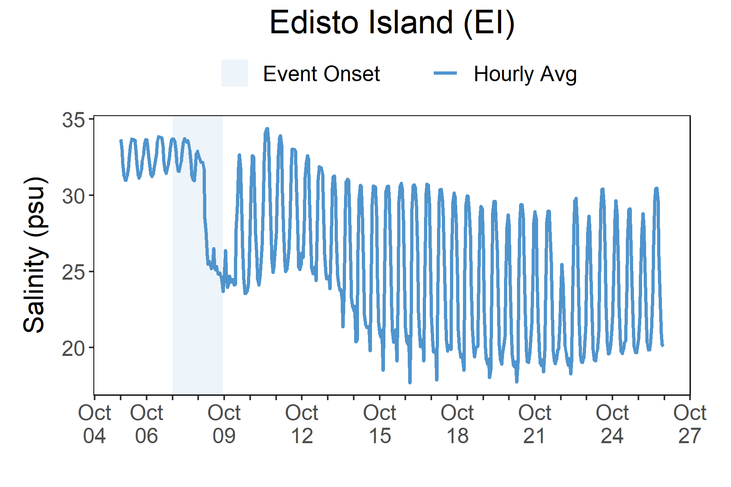
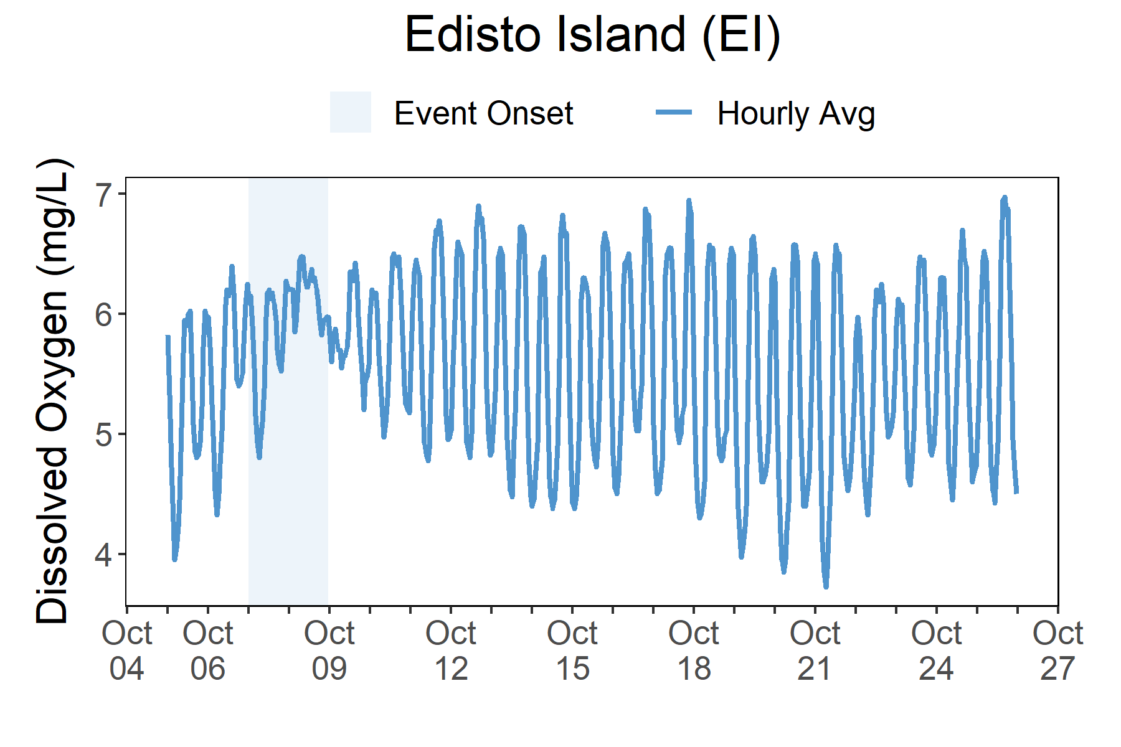
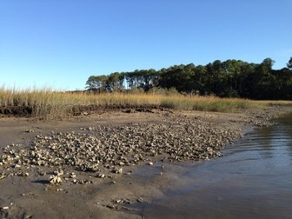
As Matthew approached the area surrounding ACE on Oct. 8, salinity levels dropped and the range in dissolved oxygen compressed.
Station | Date | Depth Maximum (ft) | Salinity Minimum (psu) | Salinity Maximum (psu) | Dissolved Oxygen Minimum (mg/L) | Dissolved Oxygen Maximum (mg/L)
Edisto Island | 10/7/2016 | 11.84 | 30.9 | 33.8 | 4.8 | 6.3
Edisto Island | 10/8/2016 | 13.06 | 24.7 | 32.9 | 5.5 | 6.5
Edisto Island | 10/9/2016 | 10.83 | 23.6 | 32.9 | 5.4 | 6.5
Edisto Island | 10/10/2016 | 11.78 | 23.4 | 34.4 | 4.8 | 6.6
Edisto Island | 10/11/2016 | 8.83 | 24.9 | 29.6 | 5.2 | 6.0
Data reporting time periods for Hurricane Matthew: 10/7/2016 - 10/11/2016
Salinity
Dissolved Oxygen
A rapid drop in salinity occurred as flooding
took place after Matthew
The regular diurnal cycle of dissolved oxygen was compressed
Salinity levels from Oct. 5 through Oct. 26.
Dissolved Oxygen levels from Oct. 5 through Oct. 26.
Salinity and dissolved oxygen levels recorded at Edisto Island (EI) show initial and post-storm impacts on water quality. Dissolved oxygen levels were impacted at the onset of Matthew. The regular diurnal variation was compressed, and levels stayed in the higher range during the flooding. Similarly, salinity levels experienced compression in its regular diurnal variation cycle but at low levels after a rapid drop in salinity. Dramatic changes in salinity oxygen can cause stress to some aquatic organisms depending on the species and how long the levels deviate from what is normal. Water quality stresses can impact survival and future populations.
Every plant and animal species have habitat preferences and requirements. Understanding these habitats is critical to understanding populations.

Slide 6


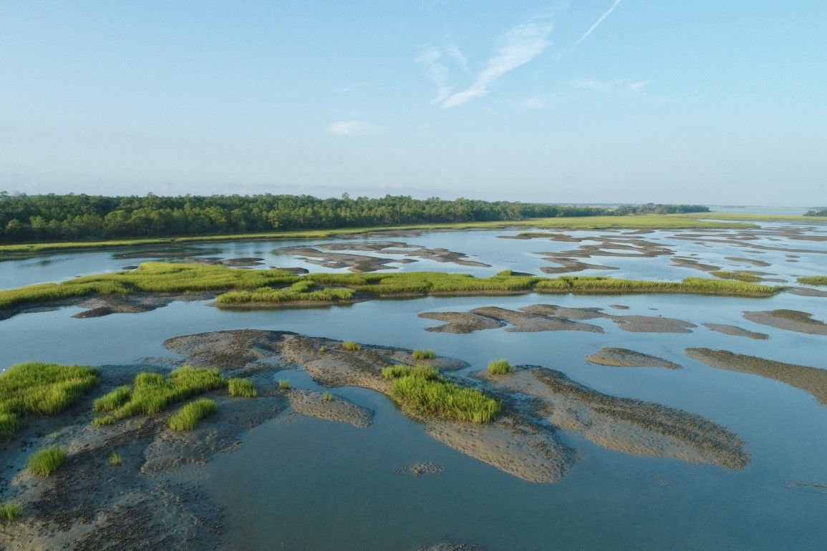

Saundra Upchurch, Research Biologist e: UpchurchS@dnr.sc.gov p: 843-953-9223
Visit www.nerrsdata.org to view and download weather and water quality data from Ace Basin NERR.
Interested in learning more? Visit www.dnr.sc.gov/marine/NERR/index.html. For video, news updates, and online storm data and prediction visualization tools, check out our Storm Story Map at www.storm storymap.url.
@estuaries

